Slide 1
Command & Visitor Patterns
by Taras Yatsyshyn Lv-273.Net

Slide 2
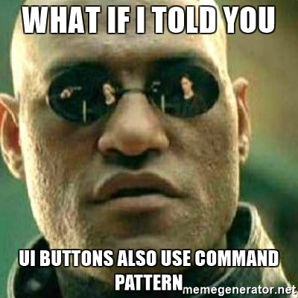
Command pattern
Command Pattern - allows you to submit a request as an object, allowing the client configuring the request (setting parameters for processing it), queuing queries, log requests, and support the cancellation of transactions.

Slide 3
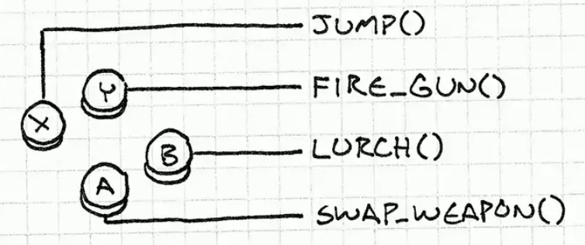

Slide 4
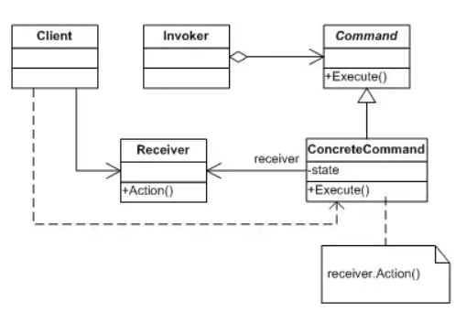
Invoker
calls
Command
Create
Implements
Client
uses
Concrete Command
calls
Receiver
Notes:
The classes and objects participating in this pattern are:
Command
declares an interface for executing an operation
ConcreteCommand
defines a binding between a Receiver object and an action
implements Execute by invoking the corresponding operation(s) on Receiver
Client
creates a ConcreteCommand object and sets its receiver
Invoker
asks the command to carry out the request
Receiver
knows how to perform the operations associated with carrying out the request.

Slide 5

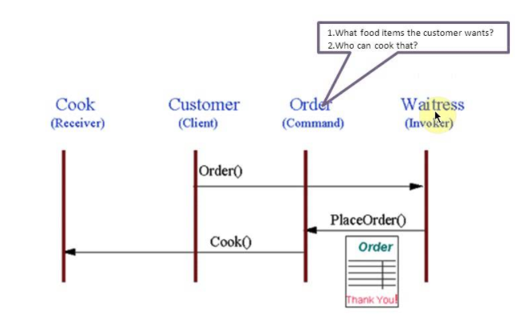
Situation in our Life
Notes:
The Command pattern allows requests to be encapsulated as objects, thereby allowing clients to be parameterized with different requests. The "check" at a diner is an example of a Command pattern. The waiter or waitress takes an order or command from a customer and encapsulates that order by writing it on the check. The order is then queued for a short order cook. Note that the pad of "checks" used by each waiter is not dependent on the menu, and therefore they can support commands to cook many different items.
https://refactoring.guru/ru/design-patterns/command

Slide 6
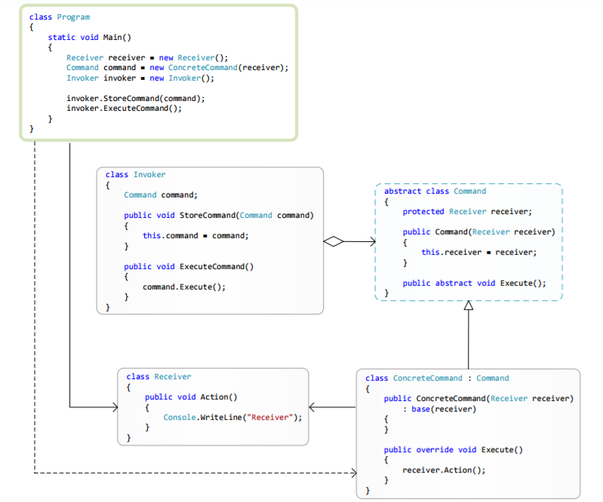
Command pattern structure in C#

Slide 7
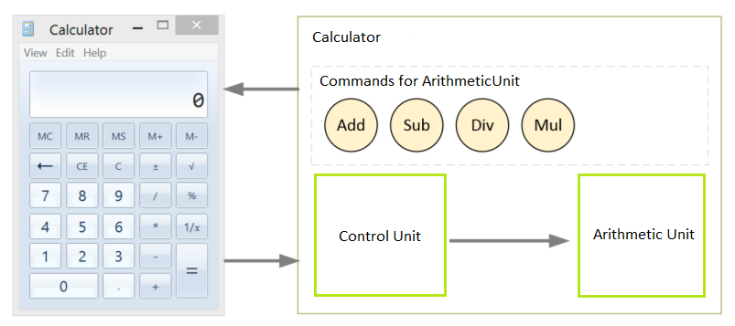
Example - Calculator

Slide 8
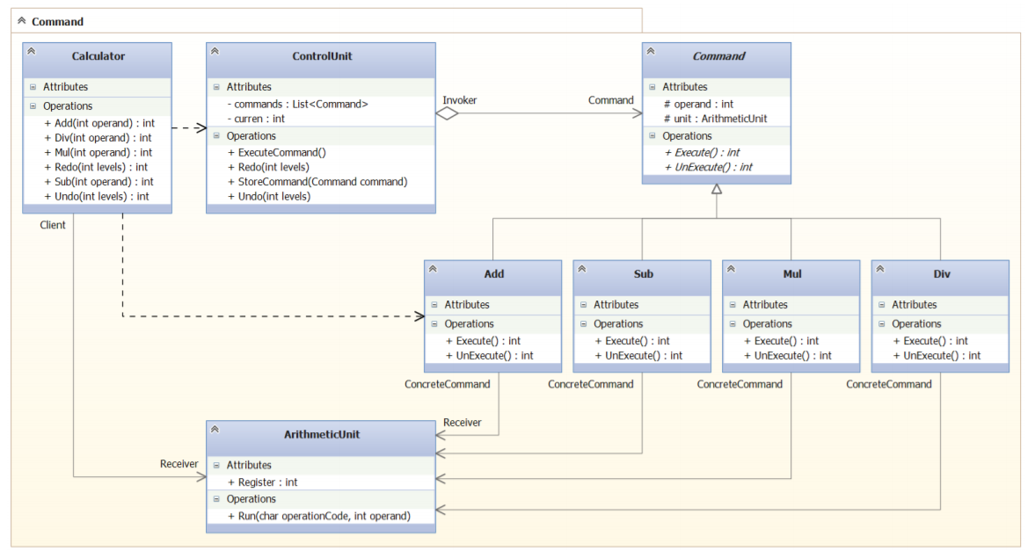
Class Diagram

Slide 9
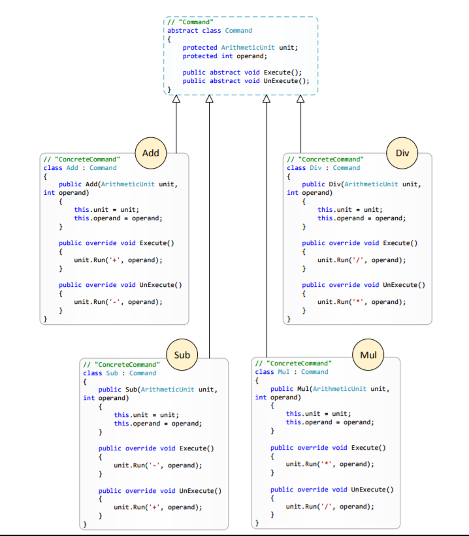
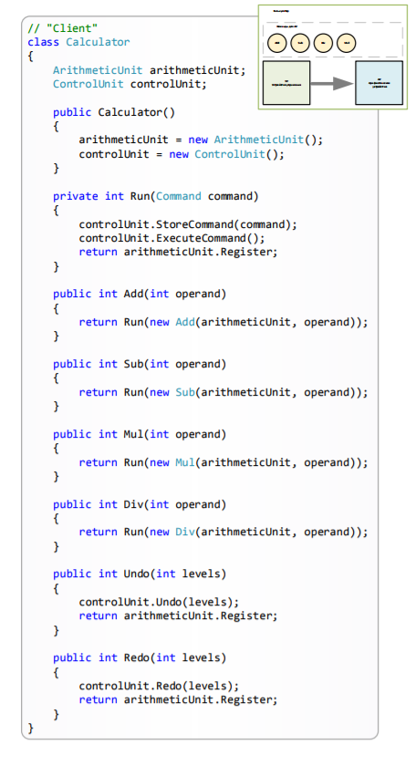
Classes

Slide 10
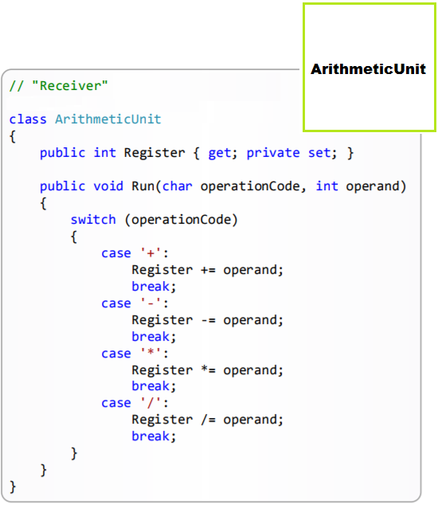
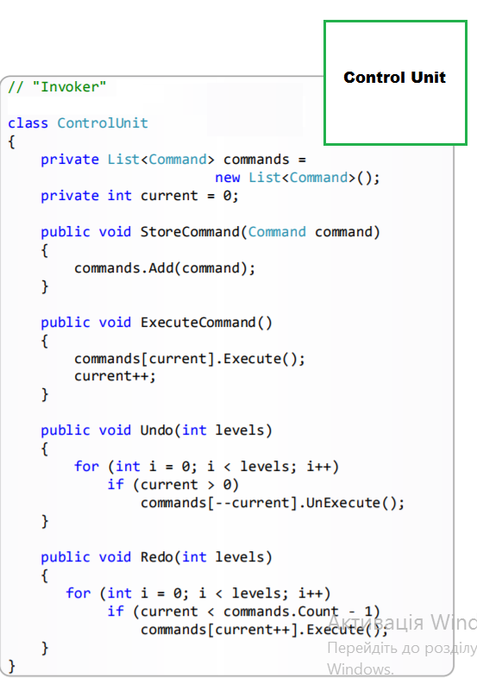
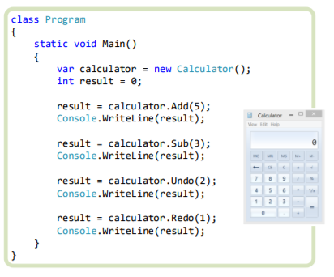
Notes:
The convenience of such a calculator construction using the Command pattern is that it is easy to add new commands that can be finely configured. You can also expand the computing capabilities of the calculator itself, for example, with a logic device or
a device for calculating floating-point numbers

Slide 11
When to use Command pattern
When you need to parameterize the command objects with the action that you perform, for example, buttons or menu items
When it is necessary to ensure cancel operation
When it is necessary to organize the time-diversity addition of requests to the queue and their execution
When you need to create a system based on transactions

Slide 12
Examples in .Net
ICommand in WPF, on the basis of which the binding of operations to events of the user interface is constructed;
IDbCommand in ADO.NET encapsulates an operation executed on the DBMS side;

Slide 13

Visitor pattern
The Visitor pattern allows you to uniformly bypass a set of elements with heterogeneous interfaces (that is, a set of objects of different classes without leading them to a common base type), and also allows you to add a new method (function) to the object class, without changing the class of this object .

Slide 14
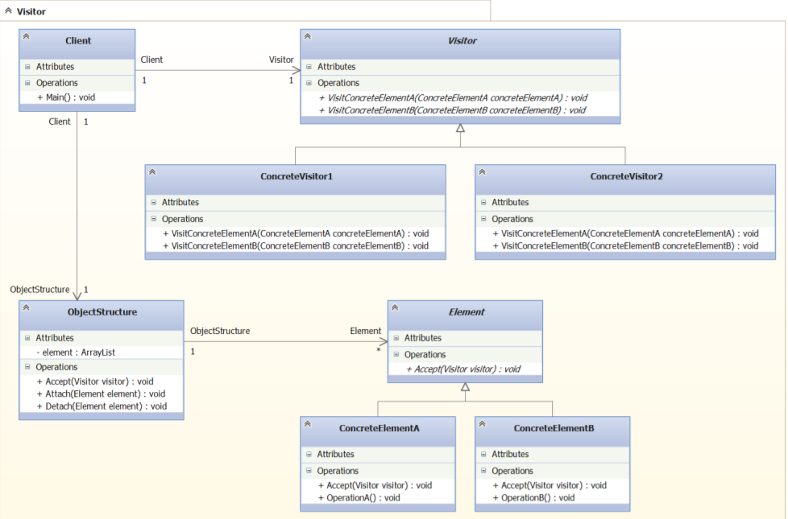
Notes:
Visitor :
Provides an abstract interface (a set of VisitConcretElementX methods) to work with
objects of class ConcreteElementX. The name of the VisitConcretElementX method includes the name
class, the instance of which causes this method.
ConcreteVisitor :
It implements the abstract interface provided by the abstract class Visitor. Each
The VisitConcretElementX operation implements a fragment of the algorithm specific to each
of a separate ConcreteElement class.
Element:
Provides an abstract Accept method that takes an argument of type Visitor.
ConcreteElement :
Implements an abstract Accept method that takes an argument of type Visitor.
ObjectStructure:
It is a collection of objects of type Element. Maybe, as an ordinary collection, so
tree-like structure.

Slide 15
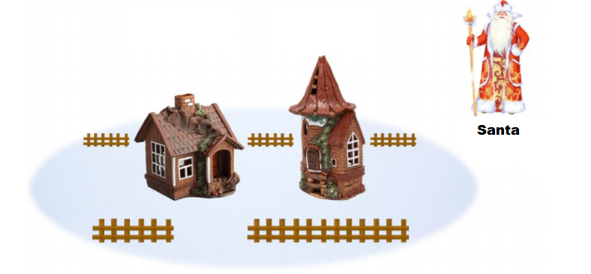
Notes:
Santa must visit all the houses in town. In one house lives a boy, in another - girl . The task of Santa Claus to visit each house and fulfill the wishes of each child (who wants what), in other words, to perform certain operations in a certain house. For example, Santa Claus will tell the boy "fairy tale" and the girl will present "dresses".

Slide 16
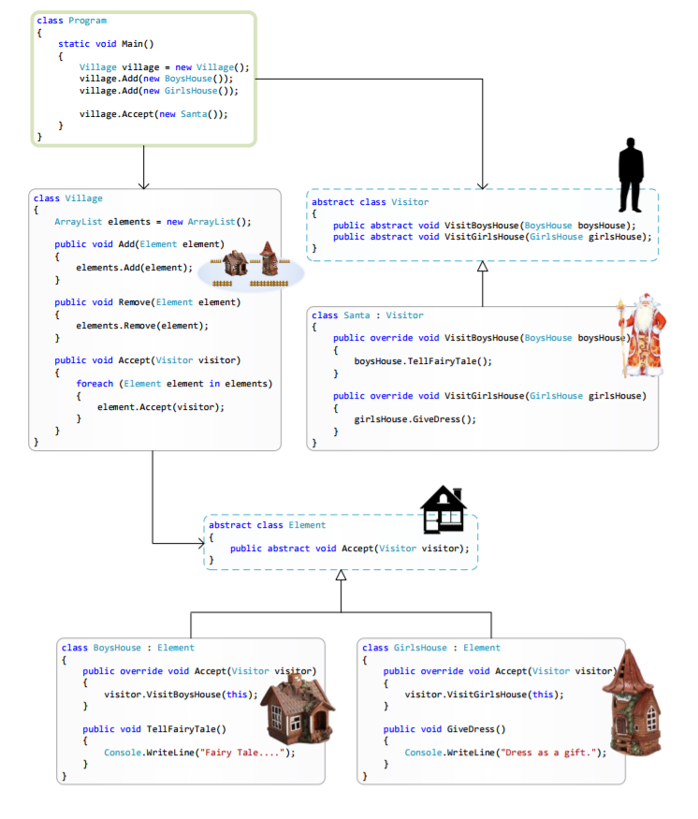

Slide 17
When to use pattern Visitor
When there are many objects of heterogeneous classes with different interfaces, and you want to perform a series of operations on each of these objects
When classes need to add the same set of operations without changing these classes
When new operations are often added to classes, the overall class structure is stable and practically unchanged

